Slide 1
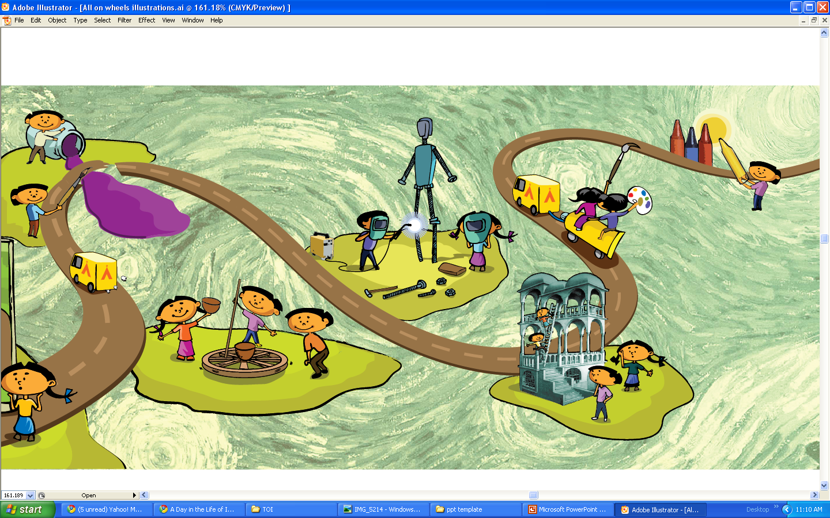

SPARKING CREATIVITY THROUGH
HANDS-ON SCIENCE EDUCATION
www.agastya.org
November 2014
shiksha . samskara . sansara

Slide 2


Slide 3
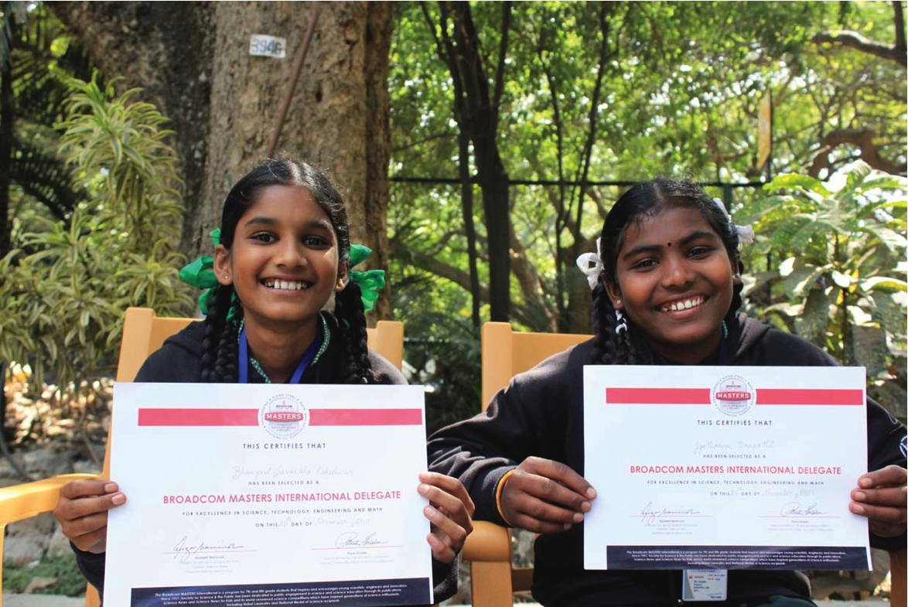
JYOTSNA AND BHARGAVI
shiksha . samskara . sansara

Slide 4
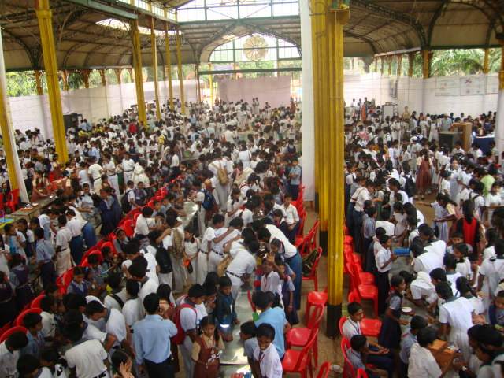
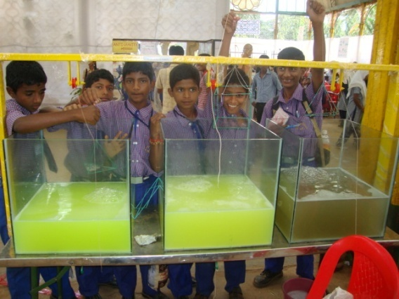
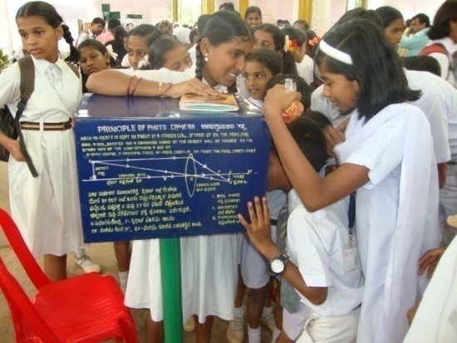
ABOUT AGASTYA
ONE OF THE WORLD’S LARGEST
HANDS-ON SCIENCE EDUCATION PROGRAMS
FOR DISADVANTAGED CHILDREN
AND RURAL TEACHERS
shiksha . samskara . sansara

Slide 5
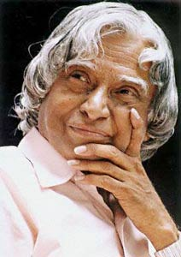
ABOUT AGASTYA
The lesson we derive out of [the Agastya] experience is that innovative and student friendly solutions are needed to enable scientific learning in the youth, especially those in rural and remote regions of the nations of the world.
Former President of India,
Dr. A.P.J. Abdul Kalam,
speaking at the 11th International Conference on Public Communication of Science and Technology
shiksha . samskara . sansara

Slide 6
AGASTYA VISION
Creatively skilled India…
Entrepreneurially enabled …
Improving the environment to…
Sustain it for future generations.
Creative Rural India
Creators
Tinkerers
Solution - seekers
Humane
Anchored
Connected
shiksha . samskara . sansara

Slide 7
MISSION
Spark Curiosity and Creativity through
Experiential, hands-on science education
Teacher education
Scalable learning methods
Sustainable and environment friendly
Make learning
Fun!
Useful!
Accessible!
"The important thing is not to stop questioning. Curiosity has its own reason for existing."
shiksha . samskara . sansara

Slide 8
AGASTYA INFLUENCES KEY BEHAVIORAL SHIFTS
Yes to Why
Looking to Observing
Passiveness to Exploring
Textbook-bound to Hands-on
Fear to Confidence
Acceptance to Leadership
Agastya’s Model recommended by National Knowledge Commission
shiksha . samskara . sansara

Slide 9
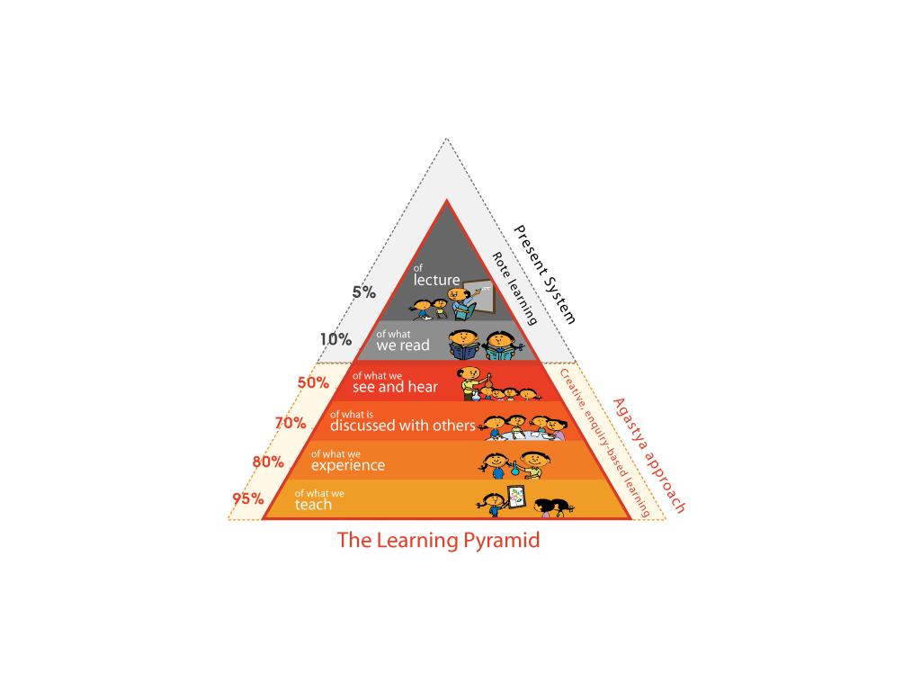
PEDAGOGY BASIS
We Learn
Leadership
Creativity
Problem solving
Curiosity
Awareness
shiksha . samskara . sansara

Slide 10
TARGET AUDIENCE - STAKEHOLDERS UNIVERSE
Resource
Persons
Teachers
Partners
Schoolchildren,
Dropouts
Government
NGOs
YIL
0.2%
2 %
100 %
3 %
Young
Instructors
Parents &
Community
Media
Investors/Donors
shiksha . samskara . sansara

Slide 11
STABILIZING MASS-AWARENESS PROGRAMS THROUGH HIGHER-INTENSITY PROGRAMS
Leadership
Young Instructor Leaders
(Target: 1 mn)
Innovation
BUCKET
Creativity
Young Instructors, Teachers
(Target: 4 - 6 mn)
Problem solving
RIVER
Curiosity
Schoolchildren,
dropouts
(Target: 50 mn +)
Awareness & Motivation
OCEAN
Intensity of the program
shiksha . samskara . sansara

Slide 12

THE AGASTYA MODEL
NATIONWIDE
KNOWLEDGE
DISTRIBUTION
(Hub-and-spoke)
CAMPUS CREATIVITY LAB – KUPPAM
Develop, test new paradigms for learning
INTERACTIVE
LEARNING
MODELS
Science, Math,
Art & Eco
Labs
Center for
Creative
Teaching
At village doorstep
Mobile Labs
Hands-on learning
Enquiry/questioning
R & D on pedagogy
Lab-in-a-box
Science Centers
Creative life skills
TOOLS
Young Instructors
Discovery Center
IT Center/Library
Astronomy Center
Model Making
Biodiversity
Park
Art
Dance
Music
Sports
Yoga
Teacher Training
Eco models
Livelihoods
Science Fairs
Scientist - Children
Q & A
Models Software Connectivity
Holistic learning
shiksha . samskara . sansara

Slide 13



AGASTYA PROGRAMS
Hands-on science for children
Reached to date: 5M children, 200,000 teachers
Blended learning
Teacher training
Young Instructor
Leaders (P2P)
Low-cost Model making
Tod Fod Jod
Make Your Own Lab
Gifted Children
Library & Community Reading
Eco restoration
Design Thinking
40 Science Centers
100 Mobile Labs
40 LOB
14 States
50 + Districts
170 acre Campus
To be launched
Campus
100+ LIB
160 Operation Vasantha Centers

Slide 14
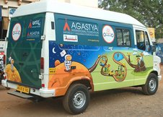
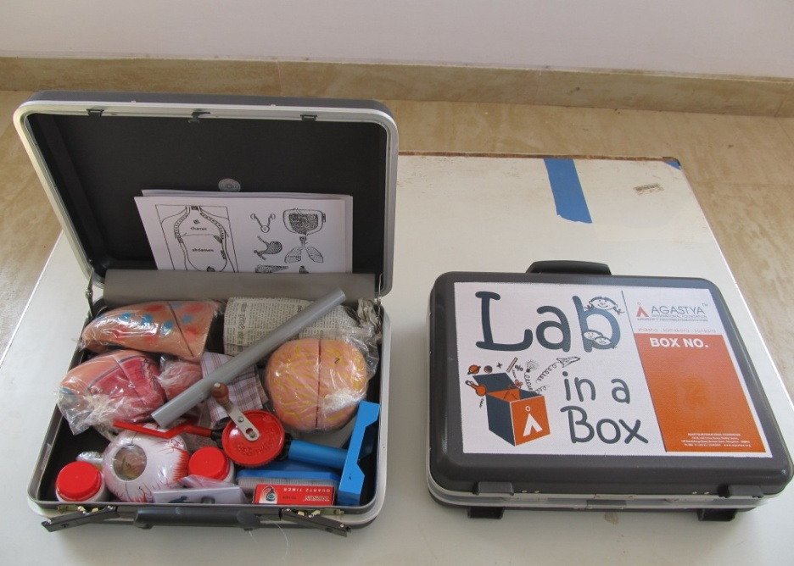
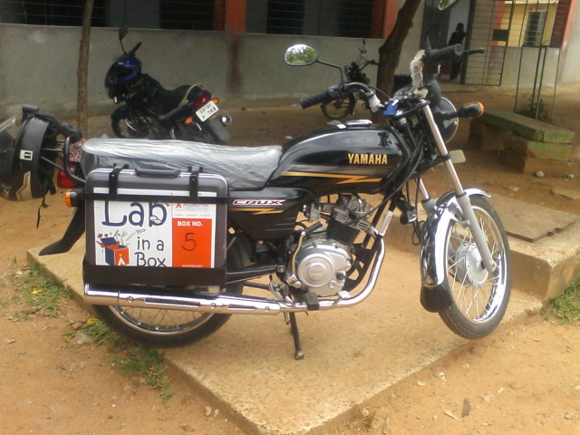
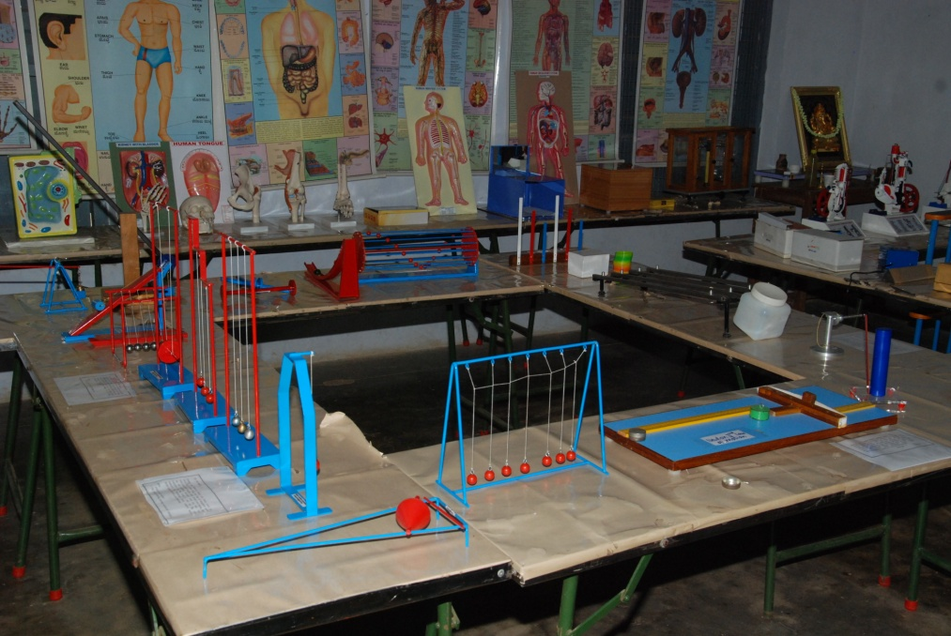
DELIVERY MECHANISMS
Mobile Lab
Science Center
Lab on a Bike
shiksha . samskara . sansara
Notes:
14

Slide 15
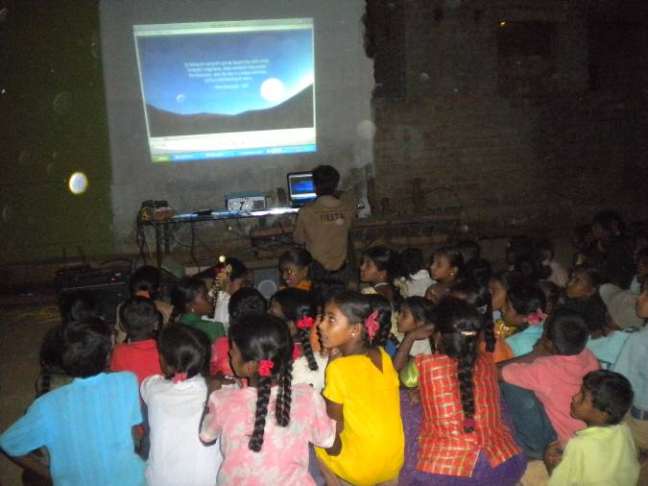
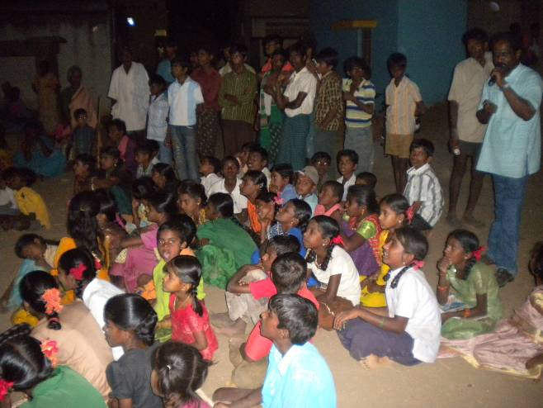
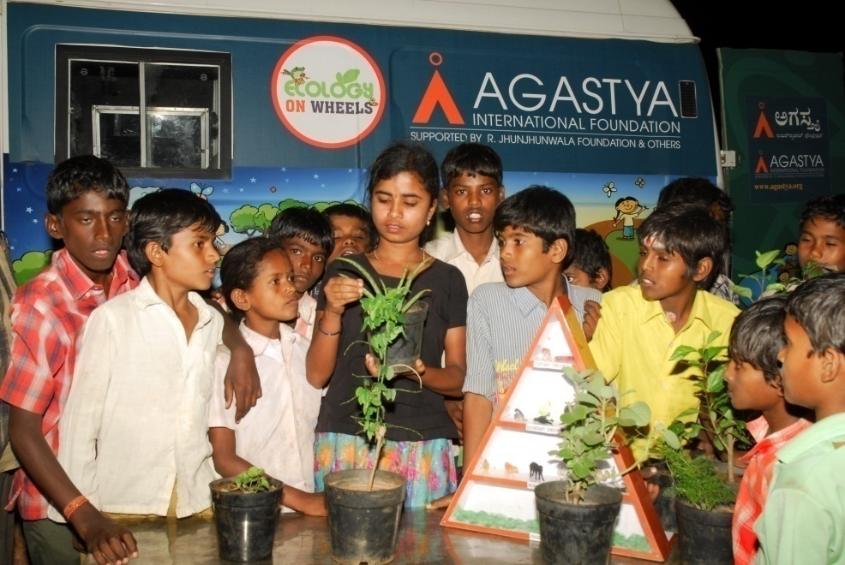
COMMUNITY OUTREACH – OPERATION VASANTHA
Transformative Volunteer Night School Program in 160 Villages to:
Increase Hands-on Learning
Build rapport with Community Leaders
Encourage parents to send children to school
Create Change Agents

Slide 16
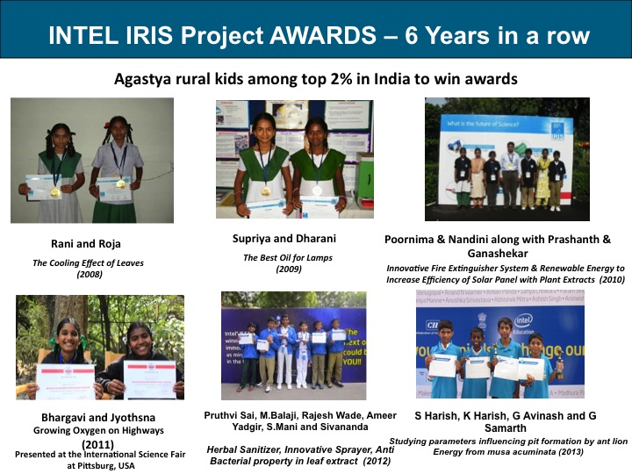
SCIENCE FOR THE COMMUNITY
IRIS - Intel NATIONAL SCIENCE AWARDS FOR SIX YEARS

Slide 17

ROLE OF A TEACHER
2ND PARENT
HAVE FUN
IGNITE
YOU ARE NOT A
SUPERMAN
MOTIVATE
PRACTICE WHAT YOU PREACH
shiksha . samskara . sansara

Slide 18








THE AGASTYA ADVANTAGE
AH! AHA! HA-HA!
Access
for All
Integrated learning experience
Holistic Development
Fun
Learning!
Promotes ‘can-do’
attitude &
innovation
Discovery and Project-based learning
Scalable and replicable
programs
Hands-on,Interactive & Investigative Approach
shiksha . samskara . sansara

Slide 19
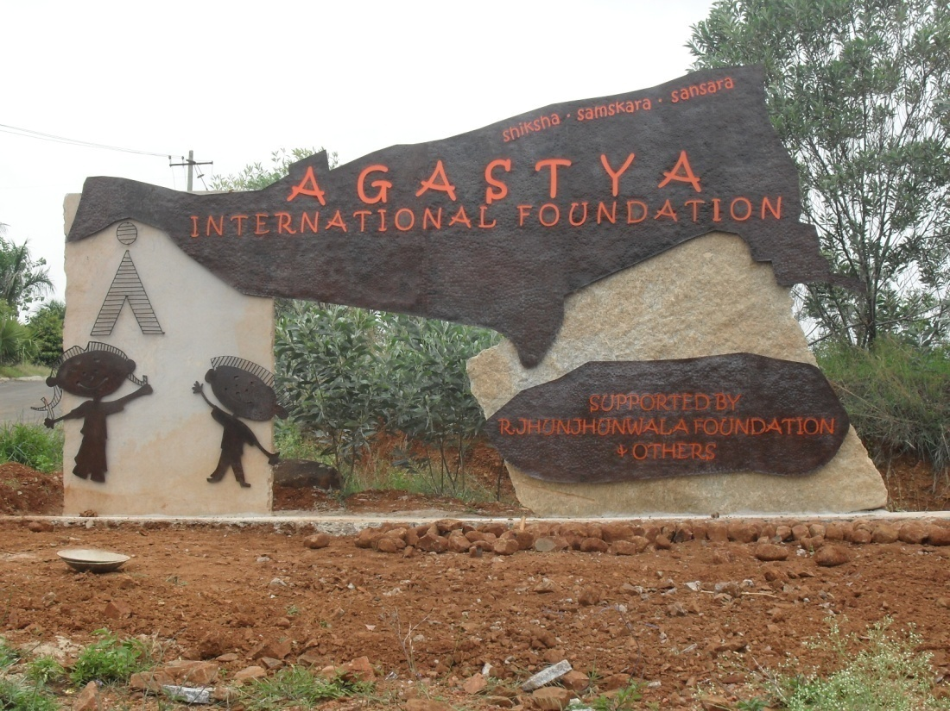
WARM WELCOME TO KUPPAM CAMPUS
shiksha . samskara . sansara

Slide 20
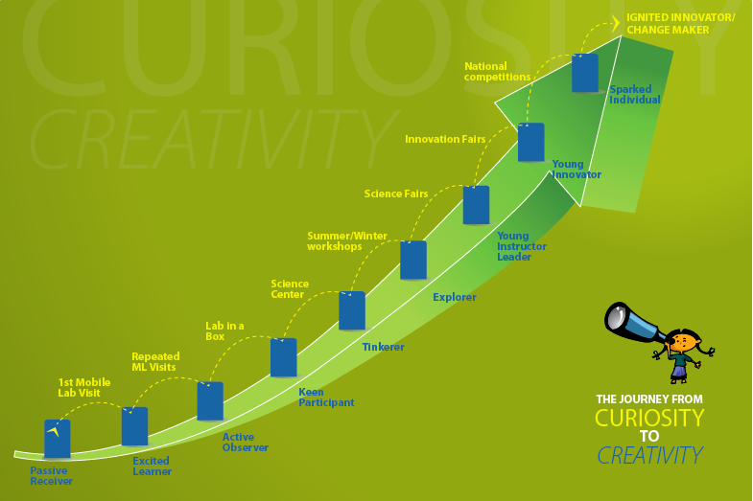
CURIOSITY TO CREATIVITY
Transforming Attitudes to Learning
‘Yes’ to ‘Why’
‘Looking’ to ‘Observing’
‘Passiveness’ to ‘Exploring’ ‘Textbook-bound’ to ‘Hands-On’
‘Fear’ to ‘Confidence’

Slide 21






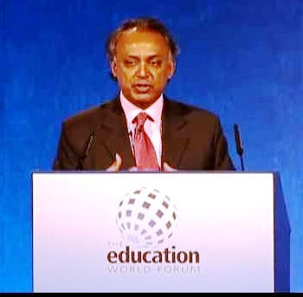


ACHIEVEMENTS AND RECOGNITIONS
Agastya Global leader of New Learner Consortium
Harvard India Conference
Next Century Innovators Award
Agastya’s ‘commitment to action’ recognized by Clinton Global Initiative
Agastya in Rockefeller Foundation's
Gallery of 100 Global Innovators
Agastya keynote at GELP, Helsinki and
National College for School Leadership, UK
shiksha . samskara . sansara

Slide 22
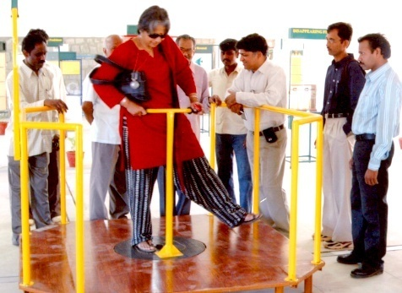
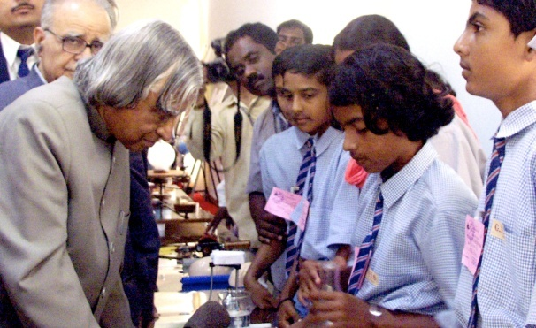
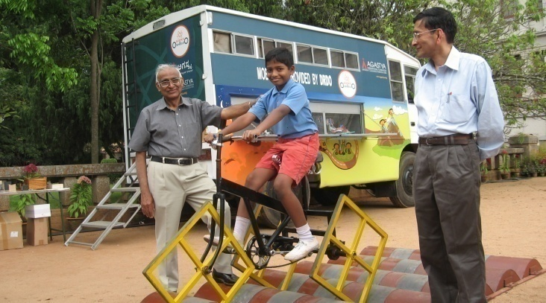
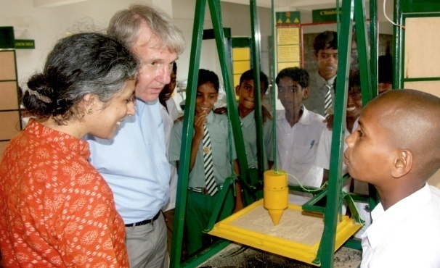
LEVERAGING THE SOCIETY
AGASTYA
CORPORATIONS
FOUNDATIONS & TRUSTS
EDUCATION, OTHER INSTITUTIONS
GOVERNMENT /PUBLIC
L & T
IBM
Google
National Innovation Council
Prime Minister’s Scientific Advisory council
State governments of AP, Karnataka, Haryana
R Jhunjhunwala Foundation
Deshpande Foundation
Infosys Foundation
Indian institute of
science
Yale school of
Management
London Business
school
shiksha . samskara . sansara

Slide 23
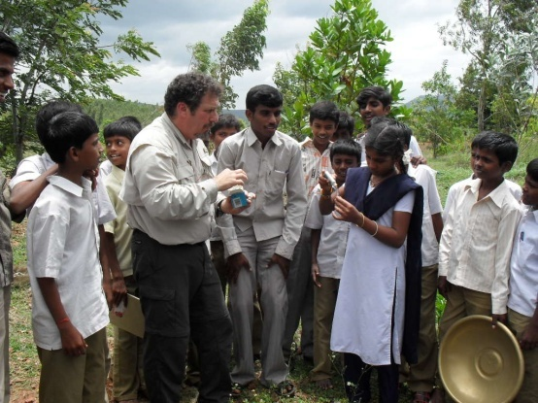
A NEW YORK TEACHERS PERSPECTIVE
“The campus is a unique site. There is no place like this in New York. Any school in the US would be the envy of the educational world if only there was an Agastya outside their front Door. “
Howard Warren,
Science Teacher
Trinity School, New York
shiksha . samskara . sansara

Slide 24
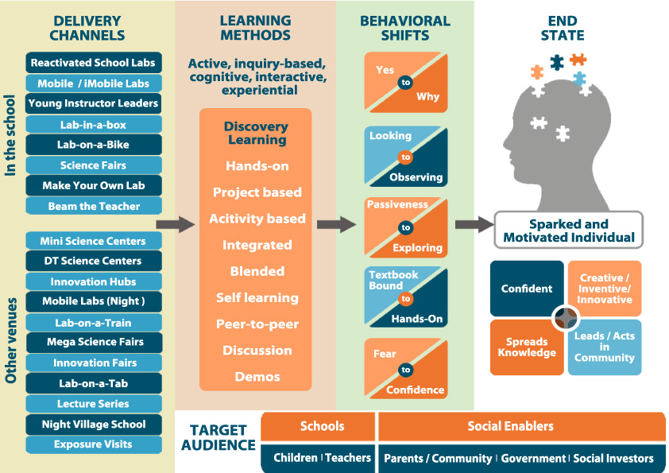
IN SUMMARY
shiksha . samskara . sansara

Slide 25
AGASTYA 2020 PLAN
Breadth
of
coverage
2025
Whole of India
2020
Exposures: 20 mn p.a.
SCs: 100
ML: 200
LOB: 200
Campuses: 3
OV Villages: 700
Staff: ~2000
States: 22
Goals
2015
Agastya
Depth of coverage
Propagate
through trained
Teachers
Infuse scientific temper in Children
Fundamental impact
shiksha . samskara . sansara

Slide 26


THANK YOU

